Slide 1
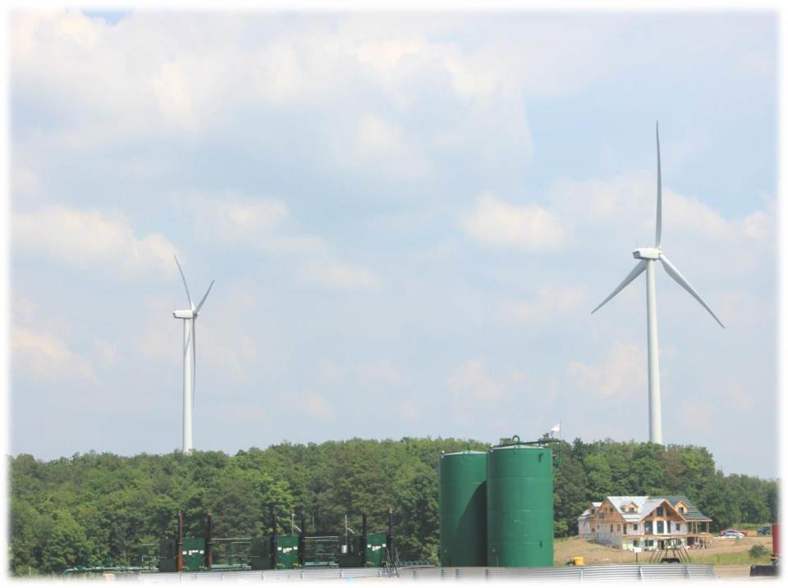
Understanding Shale Gas Development From drilling to end user…..

Slide 2
Key Questions
What is the development process and why is it important?
Where are various materials, equipment & labor sourced, how are they handled on site, what happens to them after use?
What are the implications of development – landowner, local business, workforce, community, environment?
Are other technologies available and what are the trade-offs?

Slide 3
Discussions Continue to Evolve
Information sources varied, differing levels of accuracy and quality.
Scientific process, scientific uncertainty.
Role of media and social media?
Dynamic, fast-paced change (technology, regulations and policies, markets, etc.).
Polarization (is it growing?).

Slide 4
Segments of the Oil and Gas Industry
Exploration and Production (Upstream)
Home Heating/Cooking
Gathering, Compression, Treating, Processing, Transportation (Midstream)
Petrochemical and Refining (Downstream)
Electric Power
Gathering Pipelines
Gas Treating, Processing and Fractionation
Interstate Gas
Pipelines
Industrial Boilers/Furnaces
Natural Gas
(Methane)
LNG (Liquefied and shipped)
Gas
CNG (Fleet Fuel, Buses, etc)
Compression
Oil, Gas, Water
Separation
Propane
Home Heating, Cooking
Transportation, Industrial fuel
Water
Oil
Natural
Gasoline
Ethane
Well
Butanes
Glad Baggies
Water
Injection
Well
Plastics
Propane
Petrochemical
Plants
Styrofoam
Alcohols
Interstate Oil
Pipelines
Propane,
Butanes,
Gasoline's
Other Chemicals
Unleaded Gasoline
Oil and/or Gas Reservoir
5,000- 16,000 ft deep
Oil Refineries
Diesel
Jet Fuel
Asphalt
Other
Notes:
We are here to discuss everything from the well head to the plants (end users)

Slide 5
Upstream Development – Pre-Drilling
General Operations
Activities / Workforce
Leasing
Legal
Seismic
Pad Development
Others…
Leasing
Permitting
Legal
Lawyers
Abstractors
Para-legal
Civil engineering
Heavy construction
Logging & land clearing
Surveying
Mechanics
Fencing
Equipment Rental
Activities / Workforce
Hospitality services
Hotels
B&B’s
Restaurants
Convenience stores

Slide 6
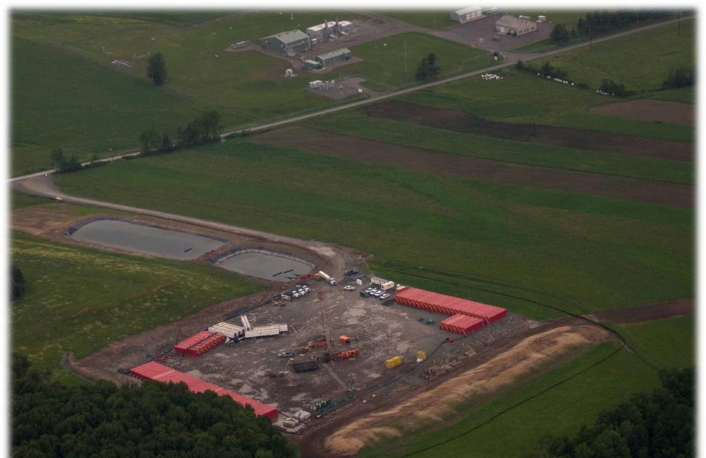
Upstream -> Siting Process
Compressor Station
Access (Lease) Road
Fresh Water Impoundment
Well pad
Pipeline access

Slide 7
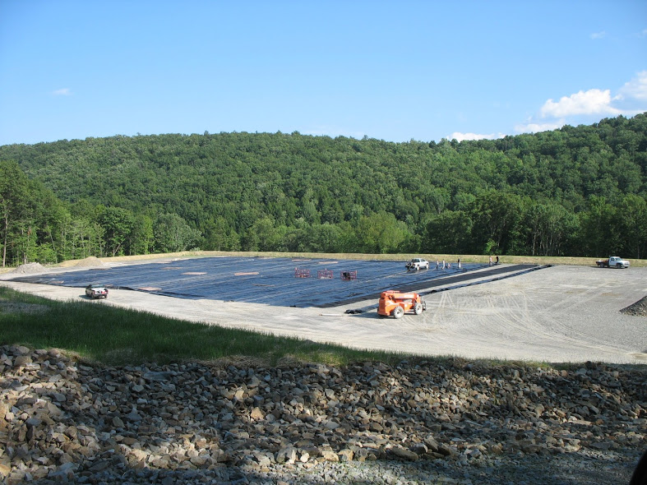
M. Madden
Notes:
Here, workers are laying a pad liner of thick plastic to minimize the possible impact of spills and leaks during drilling and hydraulic fracturing. We’ll talk more about hydraulic fracturing in a bit.

Slide 8
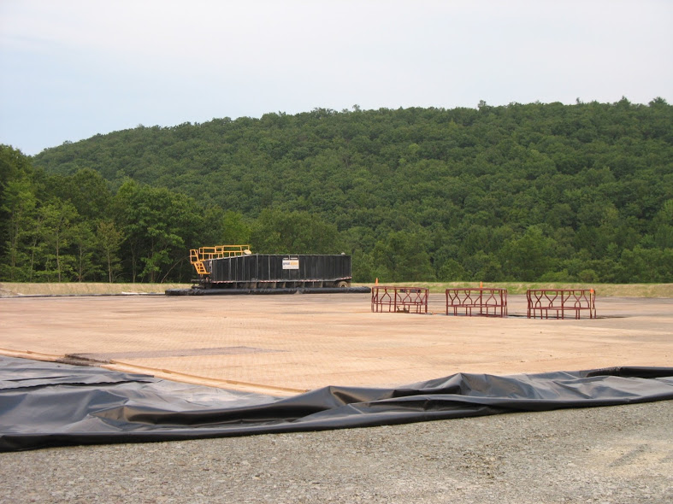
M. Madden
Notes:
Temporary safety railing is placed around the conductor holes while another type of pad protection is laid down.

Slide 9
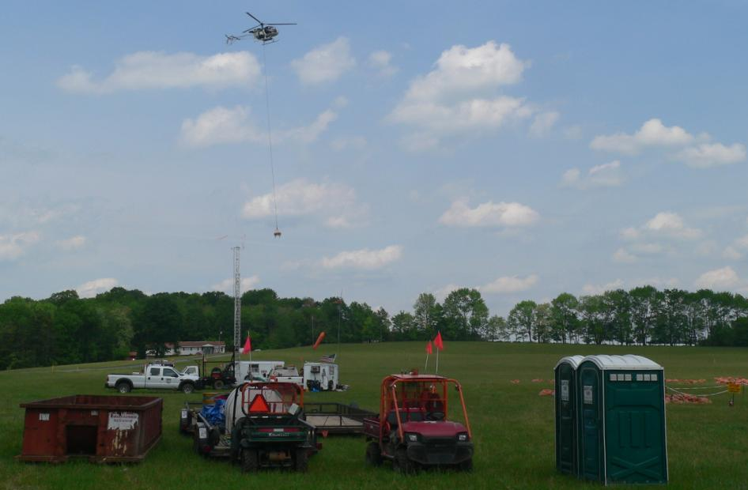
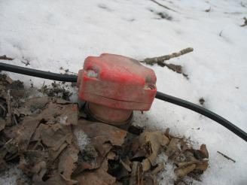
Upstream -> Seismic

Slide 10
Upstream Development - Drilling
General Operations
Activities / Workforce
Heavy hauling
Auto Sales and Service
Water handling/ management
Environmental support
Machine/fabrication shops
General welding
Mechanics & Diesel technician
Compressor technician
Pipe threading
Pressure testing
Food service
Laundry
Drilling
Casing
Cement
Solids management
Others…
Activities / Workforce
Engineering
Employment pre-screening
Workforce readiness
Hot shot
Hoses
Fluids
Wildlife Inventory

Slide 11
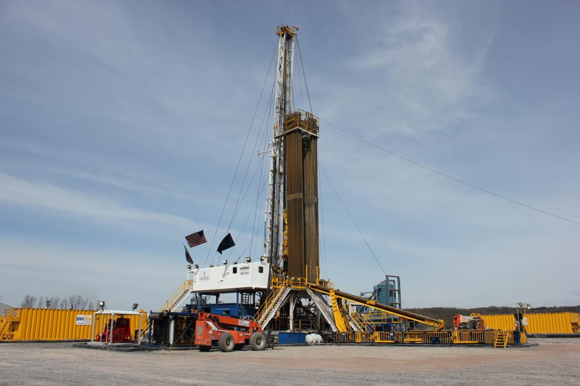
Large Rotary Rigs
Upstream -> Drilling
Power Systems
Mechanical
Electrical
LNG / CNG
Walking
“Double” or “Triple”
VIP Rig Tour
Photo Courtesy Penn State Marcellus Center

Slide 12
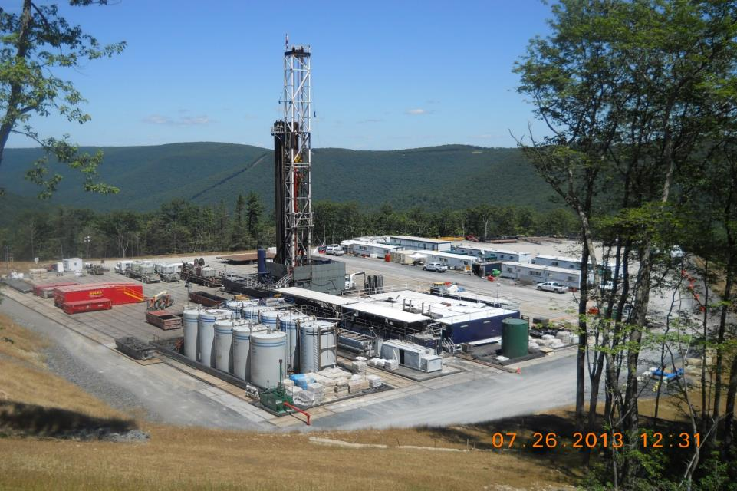
Upstream -> Drilling Pad

Slide 13
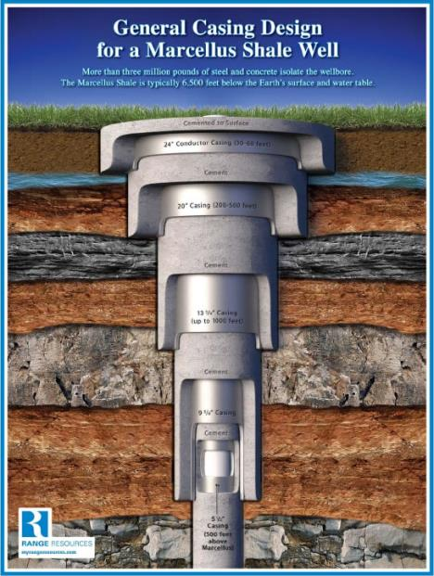
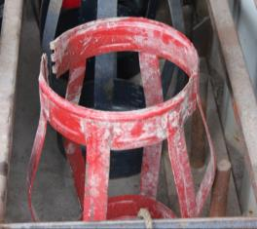
Upstream -> Well Construction
Steel Casing
Cement
Centralizers

Slide 14
Upstream Development – Post-Drilling
General Operations
Activities / Workforce
Well stimulation
Water management
Proppant & chemical management
Others….
Gas field roustabouts
Employment pre-screening
Safety equipment
Food service
Local real estate
Rail, river, and road
Service yards/buildings
Hot shot hauling
Environmental support
Permitting
Diesel technician/mechanic
Equipment rental
Activities / Workforce
Proppants / Chemicals
Commercial Trucking
Transloading/ storage/hauling
Water management
Flowback iron
Meters
ROW Work
Site Restoration
Pipes & valves

Slide 15
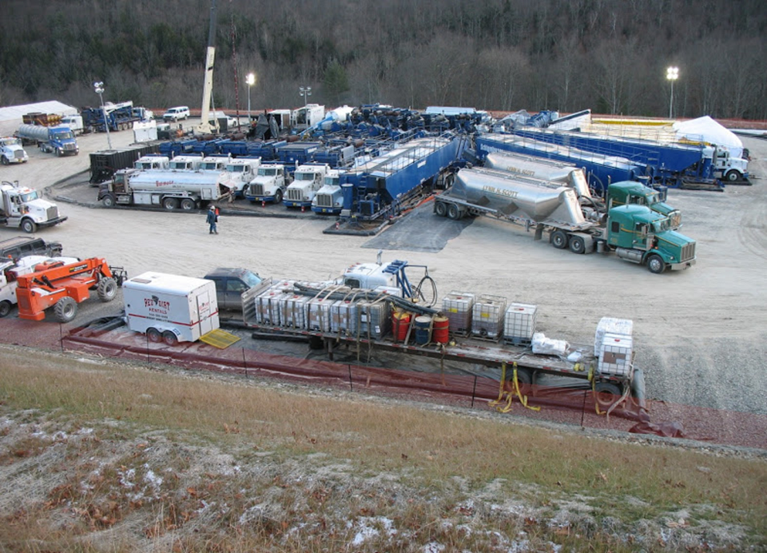
Upstream -> Completions

Slide 16
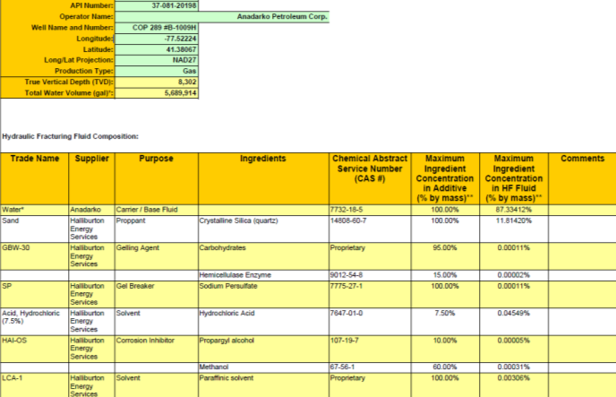
Chemical Disclosure
Fracfocus.org

Slide 17
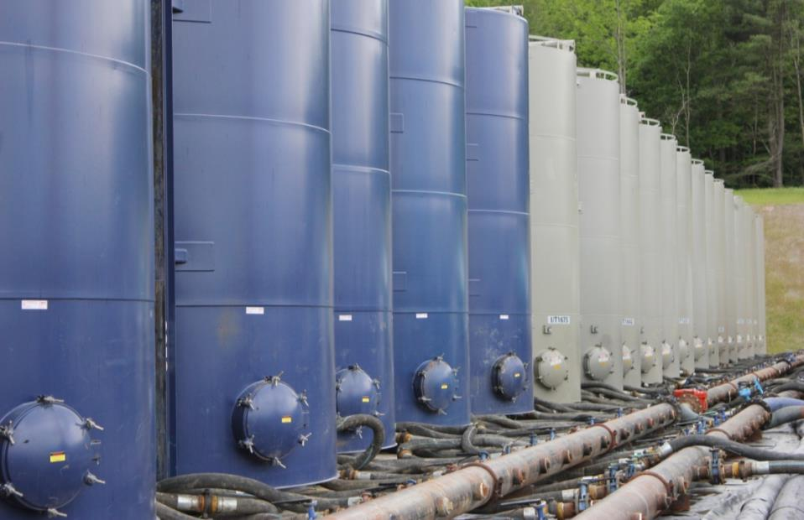
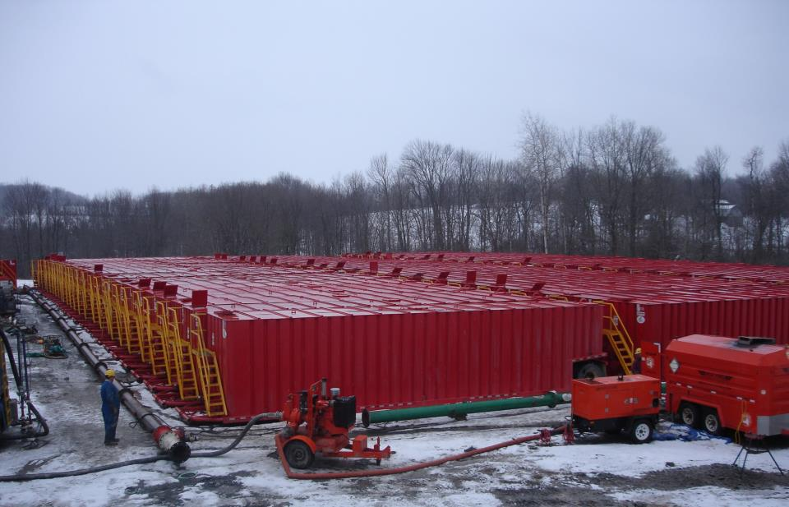
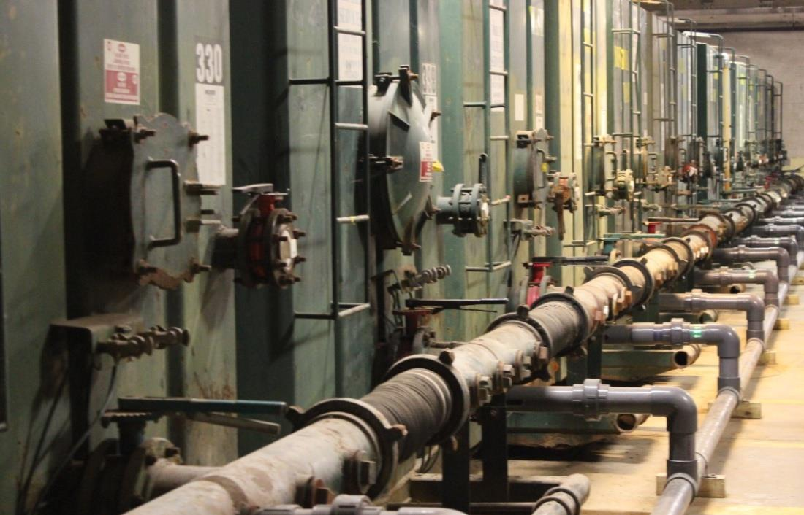
Upstream-> Water Management

Slide 18
Midstream
Activities / Workforce
General Operations
Measurement
Gathering
Compression
Construction
Processing
Treating
Land reclamation
Transportation
Others…
Construction/Fabrication
Compressor stations
Processing facilities
Custody transfer stations
Well head
Meter runs
Storage tanks
Site reclamation
Machine shops
Earth moving
Commercial trucking
Service yards/buildings

Slide 19
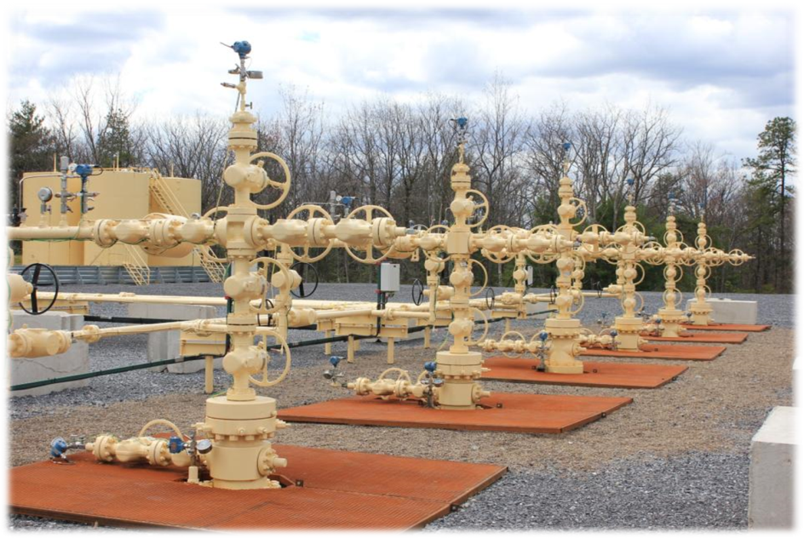
Midstream
Meter Runs
Separators
Production Tanks
Pig Launchers
Pig Receivers
Pipe Risers

Slide 20
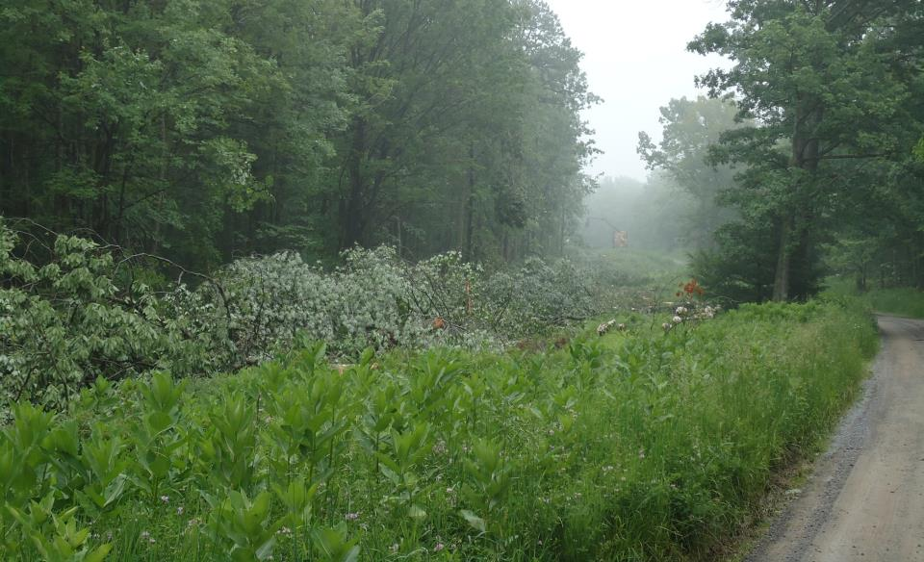
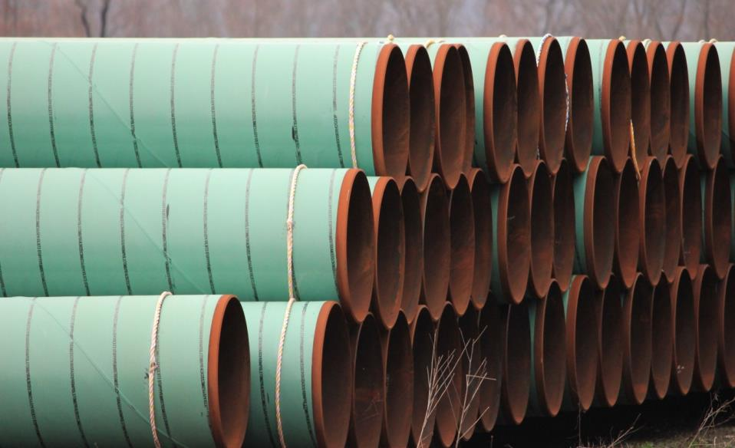
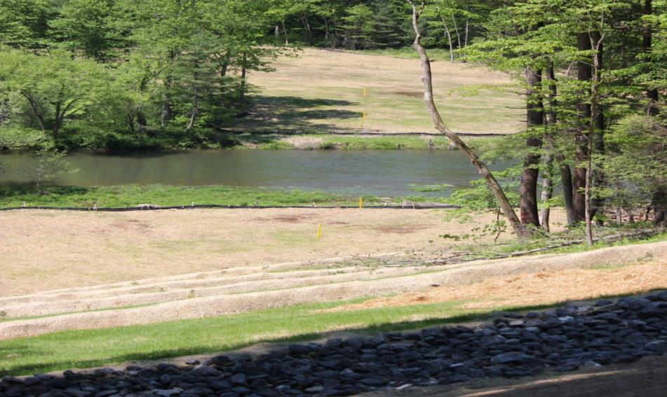
Gathering/Midstream
Midstream
Notes:
Identify the opportunities – pipeline, hauling, inspection, logistics, etc..

Slide 21
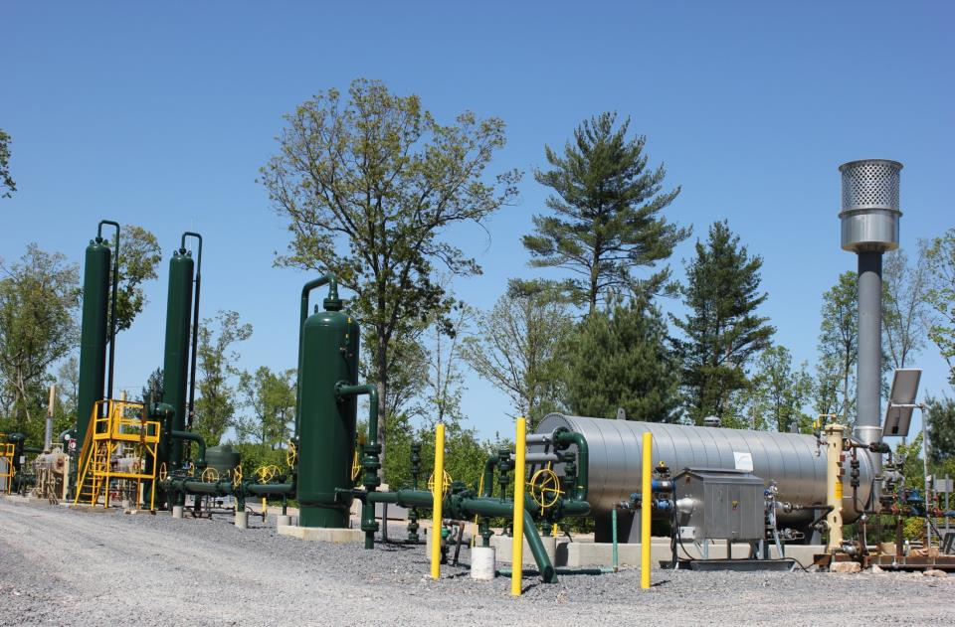
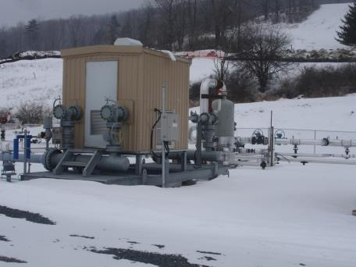
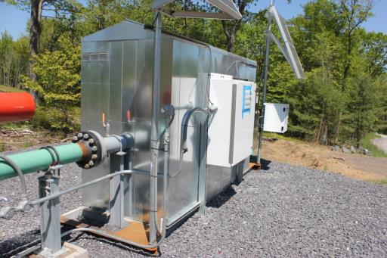
Midstream
Photo Courtesy Penn State Marcellus Center

Slide 22
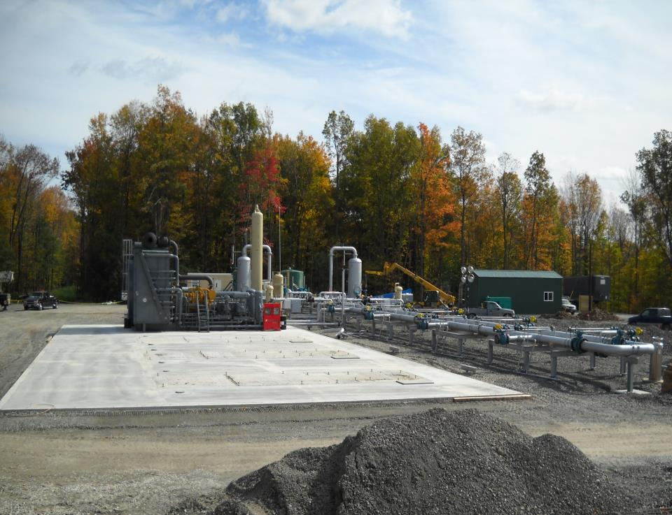
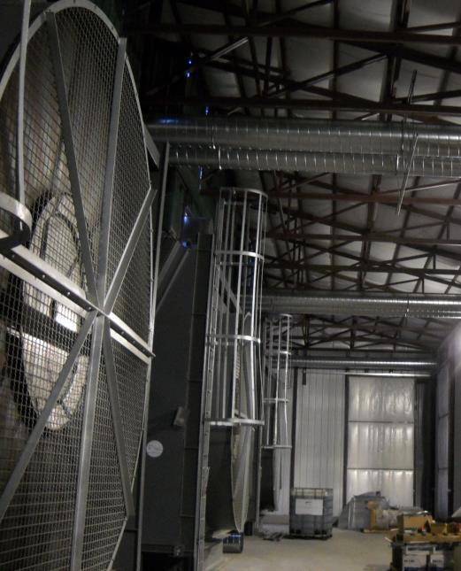
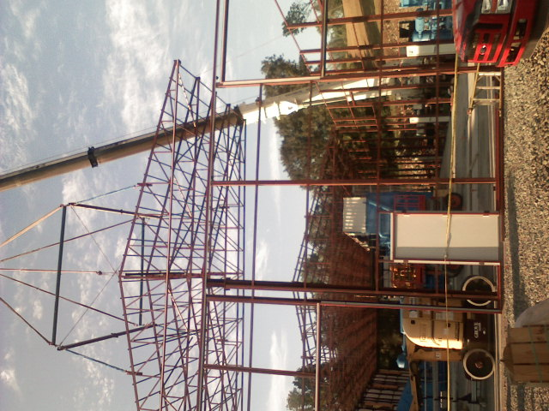
Compressor Station
Midstream Supply Chain

Slide 23
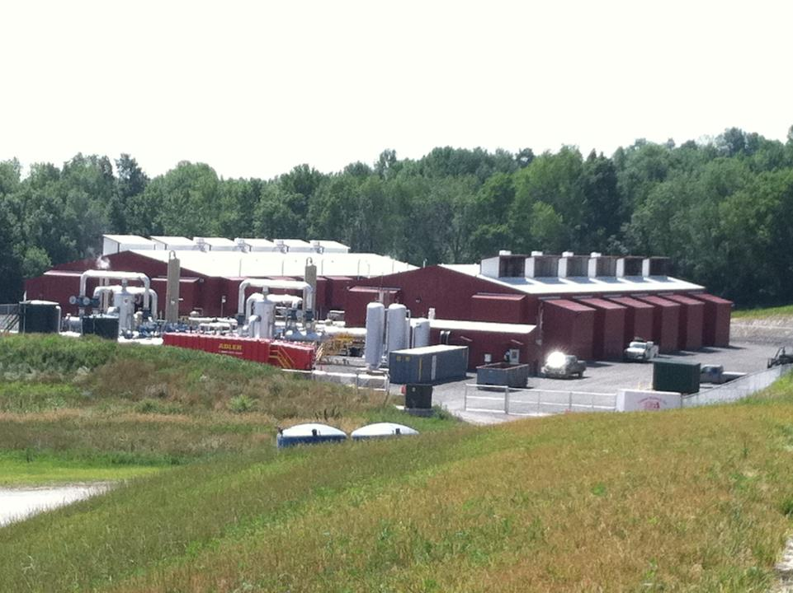

Slide 24
Emerging Technologies - Utilization
Downstream
Vehicle Conversion
Compressed Natural Gas (CNG)
Liquefied Natural Gas (LNG)
Gas to Liquids (GTL)
New engine technologies
New Fuel Formulations
Increased R & D
Residential Gas Service
Manufacturing
Paper
Steel
Glass
Petro-chemical
Ethane
Fertilizer
Fuel conversion
Power generation
Others…

Slide 25
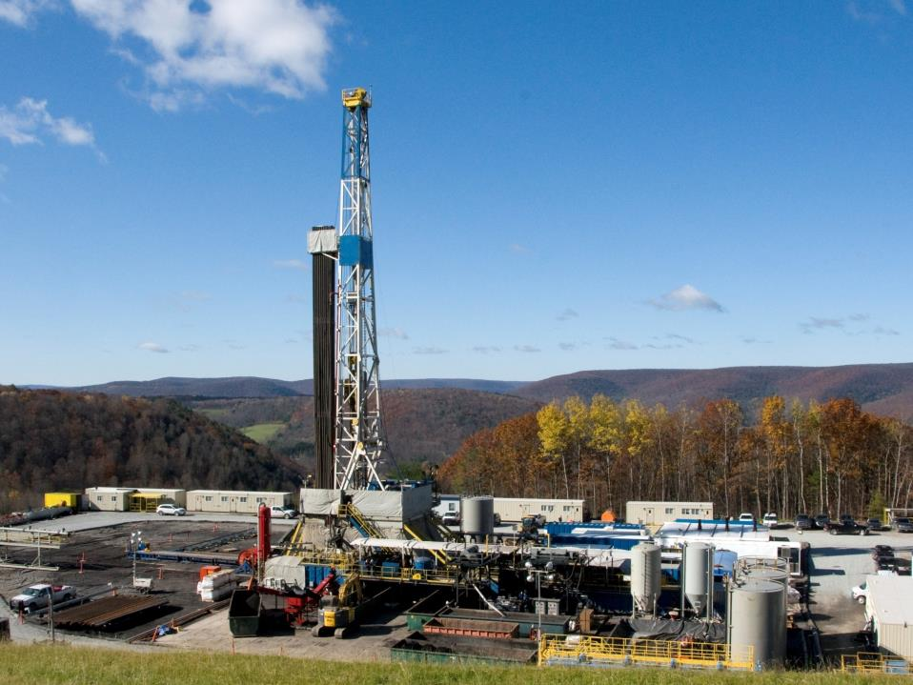
Thank You
Matt Henderson
mwhenderson@psu.edu
(570) 244-1128
Dave Messersmith
dtm101@psu.edu
(570) 253-5970 x 4110
www.marcellus.psu.edu
www.naturalgas.psu.edu
Photo Courtesy Penn State Marcellus Center

